Slide 1
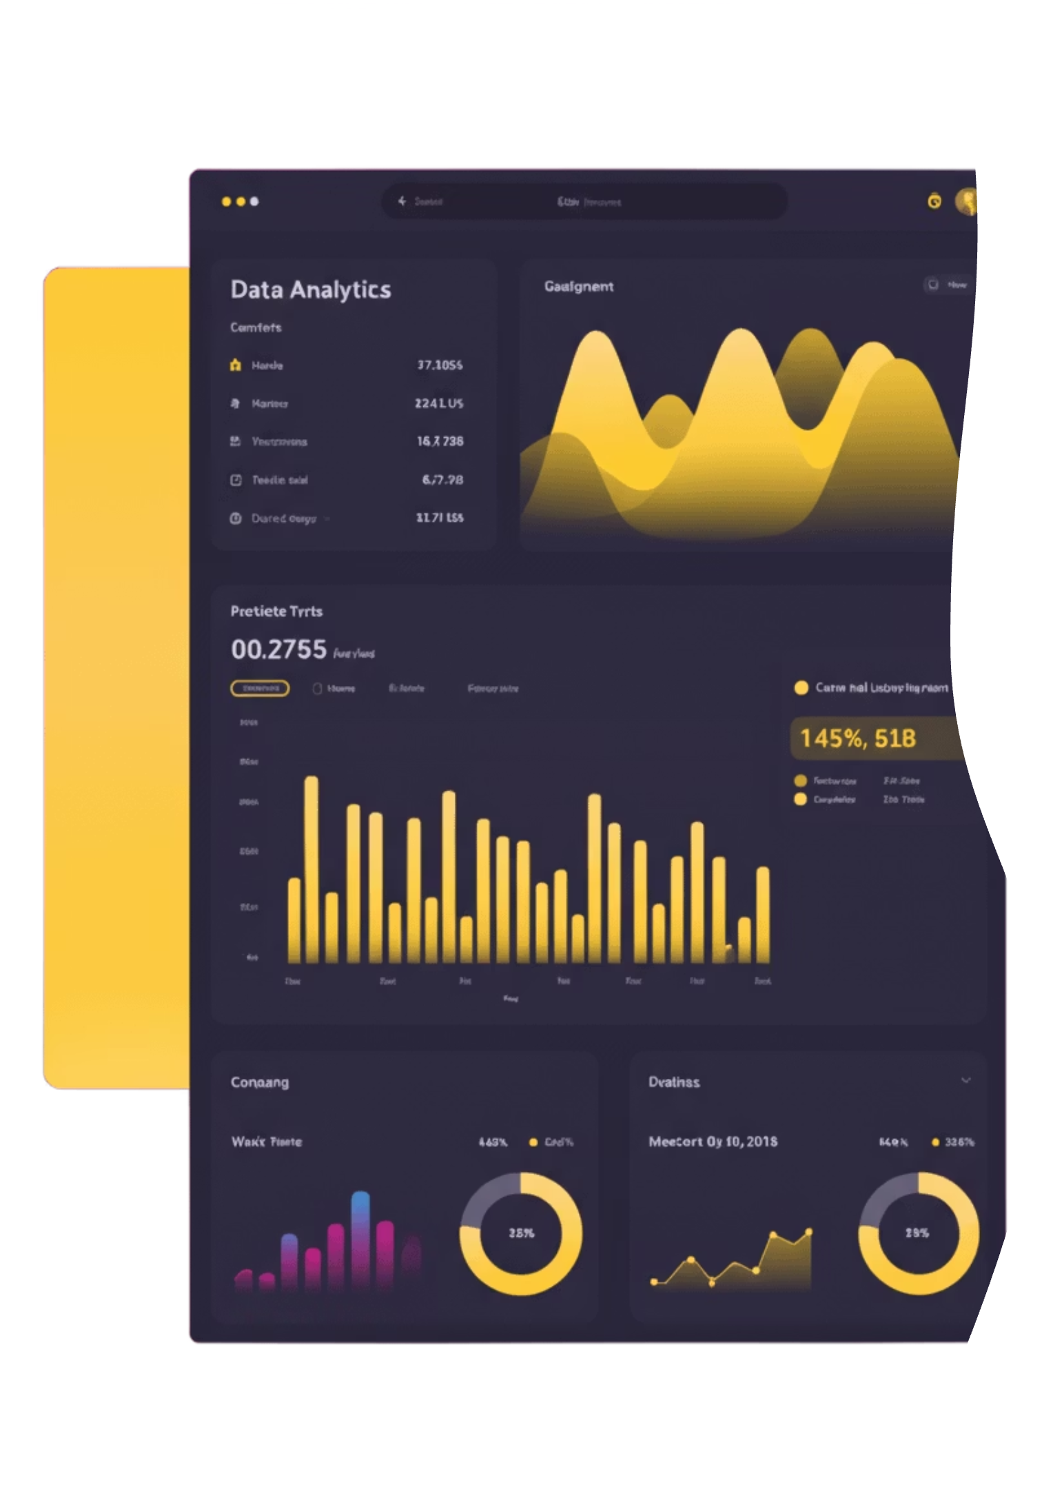
Blinkit Data Analytics
Uncovering business insights through comprehensive data analysis

Slide 2
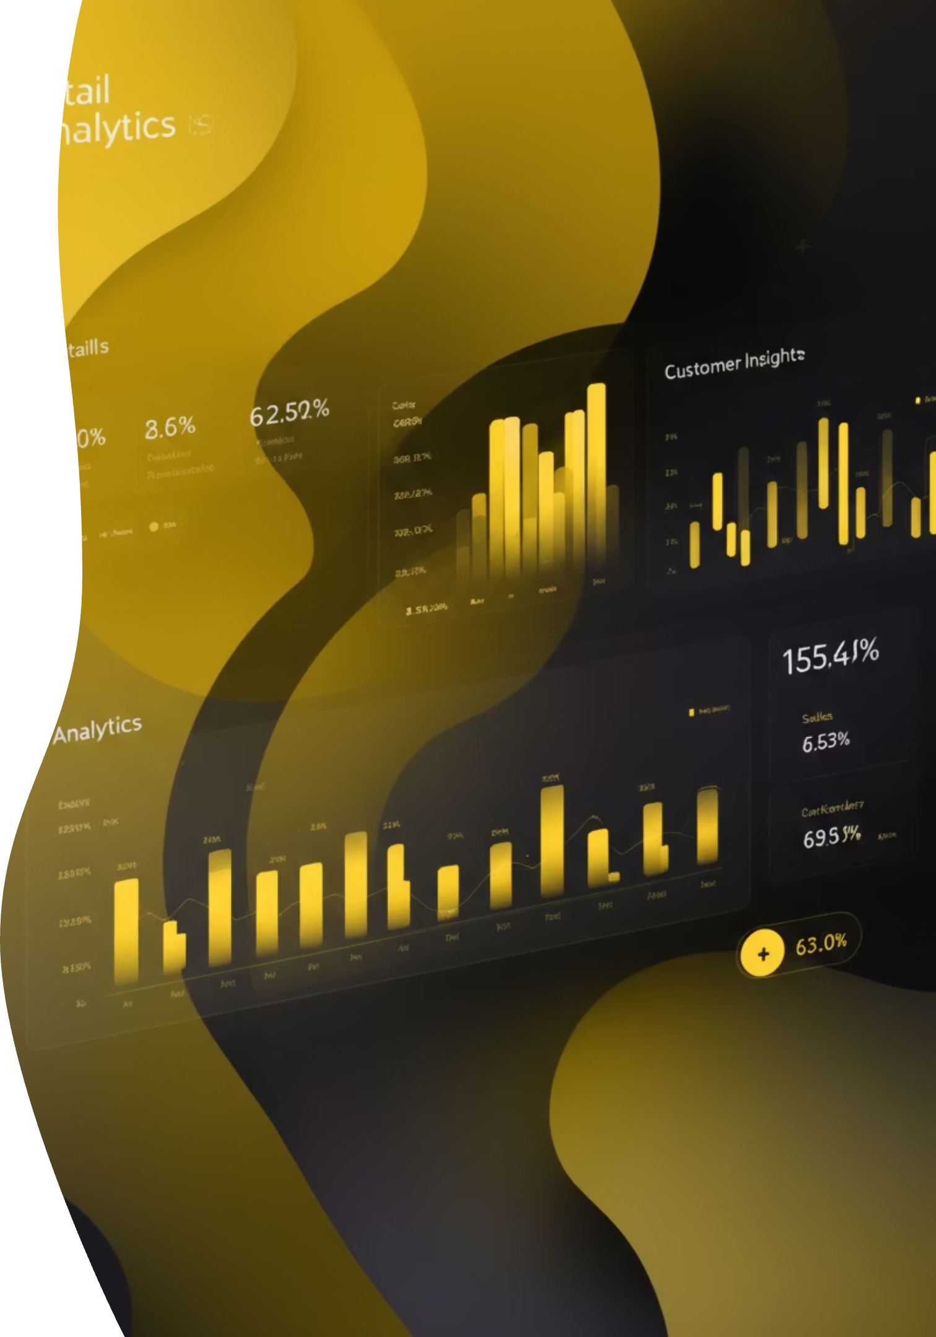
Project Overview
Analyzing Blinkit's business performance to uncover sales trends, customer behavior, and product profitability through data-driven insights.
Sales Performance
Customer Behavior
Track revenue patterns
Understand purchasing patterns
Product Profitability
Identify top performers

Slide 3
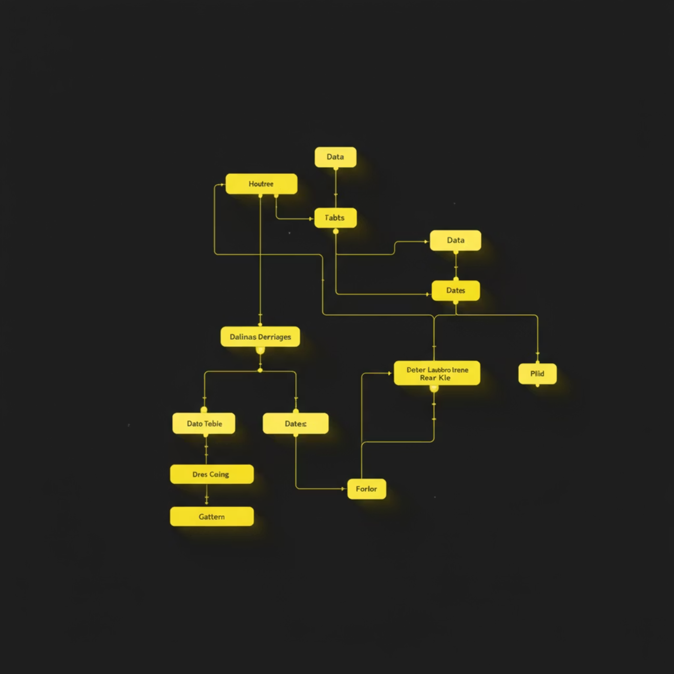
Dataset Overview
Comprehensive transactional and product-level data capturing Blinkit's retail operations
Data Elements
Item identifiers
Outlet information
Sales amounts
Product visibility
Weight & categories

Slide 4

Technology Stack
Python
SQL
Data loading, cleaning, exploration
MSSQL, Oracle, MySQL queries
Power BI
Excel
Interactive dashboards & visuals
Data review & exports

Slide 5
Analysis Process
01
02
03
Load & Inspect
Exploratory Analysis
Data Cleaning
Dataset imported and reviewed using Python
Identified distributions, missing values, inconsistencies
Transformed data for accurate analysis
04
05
SQL Validation
Power BI Design
Executed queries across multiple database systems
Connected data and created interactive visuals

Slide 6




Dashboard Insights
Key performance indicators driving strategic decisions
Total Sales
Product Visibility
By outlet type & average metrics
Performance correlation analysis
Yearly Trends
Category Breakdown
Profit comparisons & growth patterns
Sales by product category

Slide 7

Key Findings
High-Performing Outlets
Identified top outlet types driving revenue
Visibility Impact
Strong correlation between product visibility and sales volume
Optimization Needed
Low-selling regions and products require strategic focus
Consumer Patterns
Enhanced understanding of purchasing behavior through analytics

Slide 8
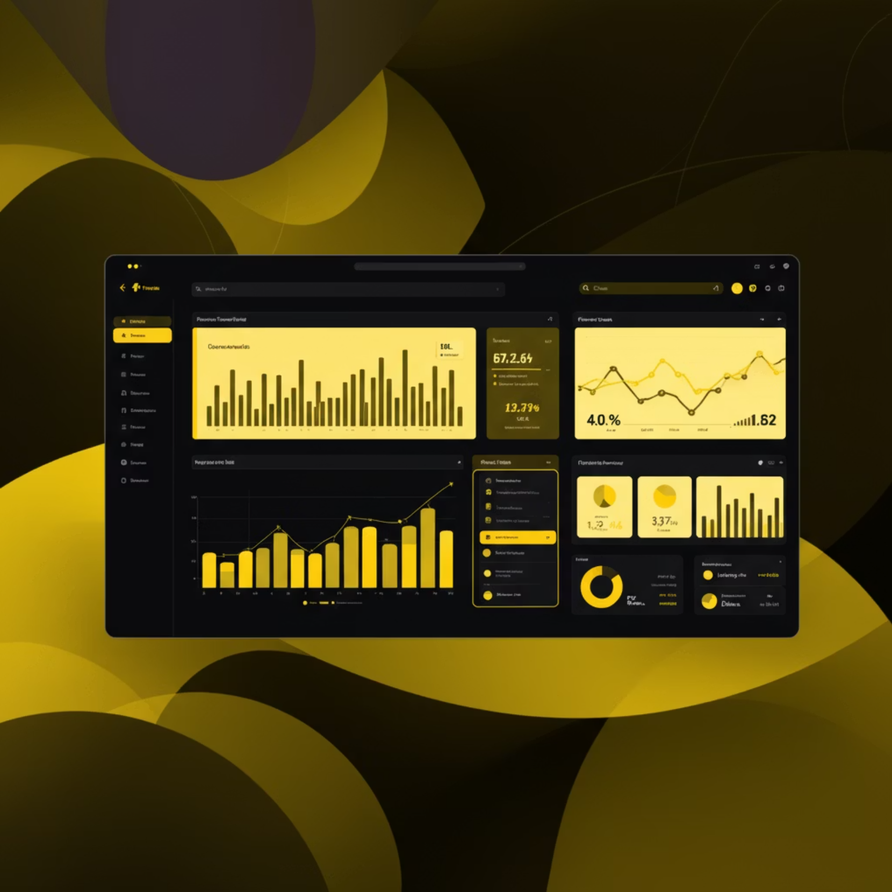
Dashboard Implementation
Getting Started
Open Blinkit Project.pbix file
Verify dataset path mapping
Refresh data source
Explore dashboard tabs

Slide 9

Impact & Value
Data-Driven Decisions
Performance Improvement
Sales and marketing teams make informed strategic choices
Targeted optimization based on insights
Growth Acceleration
Strategic focus on high-opportunity areas

Slide 10





Complete Analytics Workflow
From raw data to actionable business intelligence
Raw Data
Cleaning
Analysis
Visualization
Insights

